Slide 1
M-BLANK MANUAL FIGURES

Slide 2
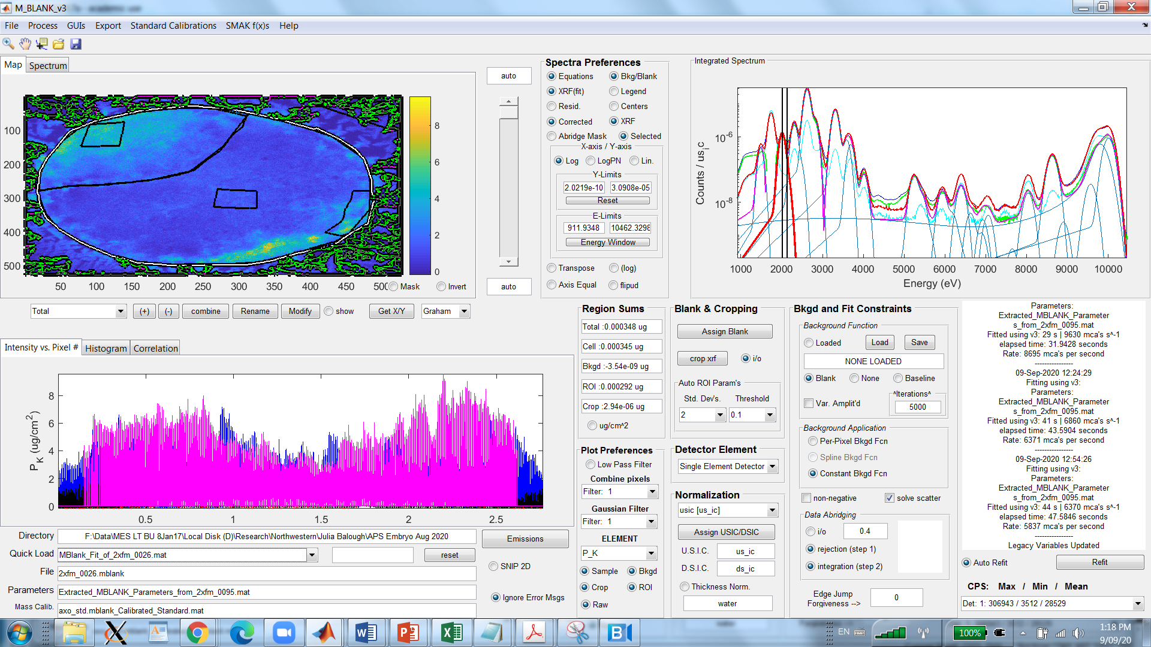
4.4
4.2
4.3
4.6
4.7
4.8
4.9
4.5
4.1

Slide 3
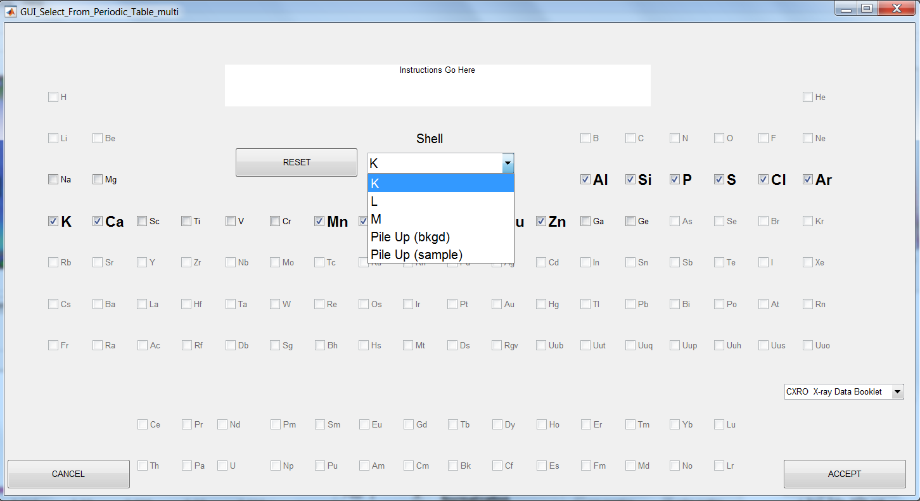
a
h
b
c
d
i
e
f
j
g
n
l
k
o
m
p

Slide 4
a
b
c
d

Slide 5
Bin | Det | Pix | Val
1 | 1 | 5 | 1
2 | 2 | 1 | 3
4 | 1 | 2 | 2
4 | 2 | 2 | 5
3 | 1 | 3 | 10
5 | 1 | 1 | 1
1 | 2 | 4 | 3
Bin | Det | Pix | Val
1 | 1 | 5 | 1
3 | 1 | 3 | 10
4 | 1 | 2 | 2
5 | 1 | 1 | 1
1 | 2 | 4 | 3
2 | 2 | 1 | 3
4 | 2 | 2 | 5

Slide 6
uicontext menu (mouse r-click)

Slide 7
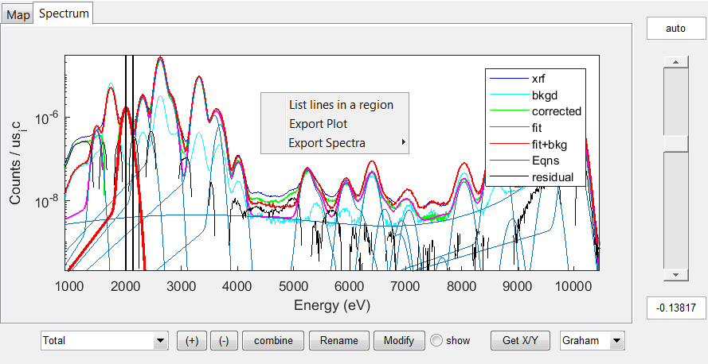
p
a
b
n
s (uicontext menu; mouse r-click)
r (uicontext menu; mouse r-click)
q
l
m
o
c
d
e
f
g
h
i
j
k

Slide 8
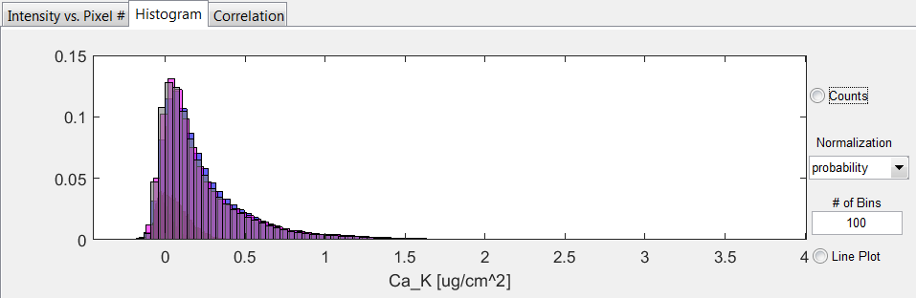
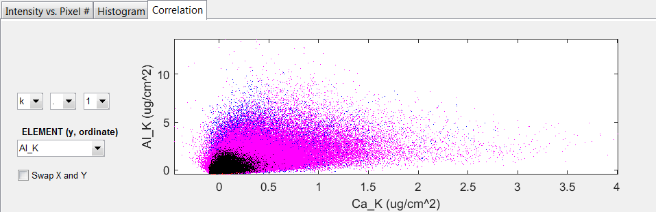
a (uicontext menu; mouse r-click)
b (uicontext menu; mouse r-click)
d
e
f
g
h
c (uicontext menu; mouse r-click)
i
j

Slide 9
a
b
c
d
e
f
g

Slide 10
b
a
c
d
e
f
g
h
i
j

Slide 11
a
b
c
d
e
f
g
i
h
j
k
l
m
n
o
p
q

Slide 12
a
b
c
d

Slide 13
Parameterization GUI

Slide 14
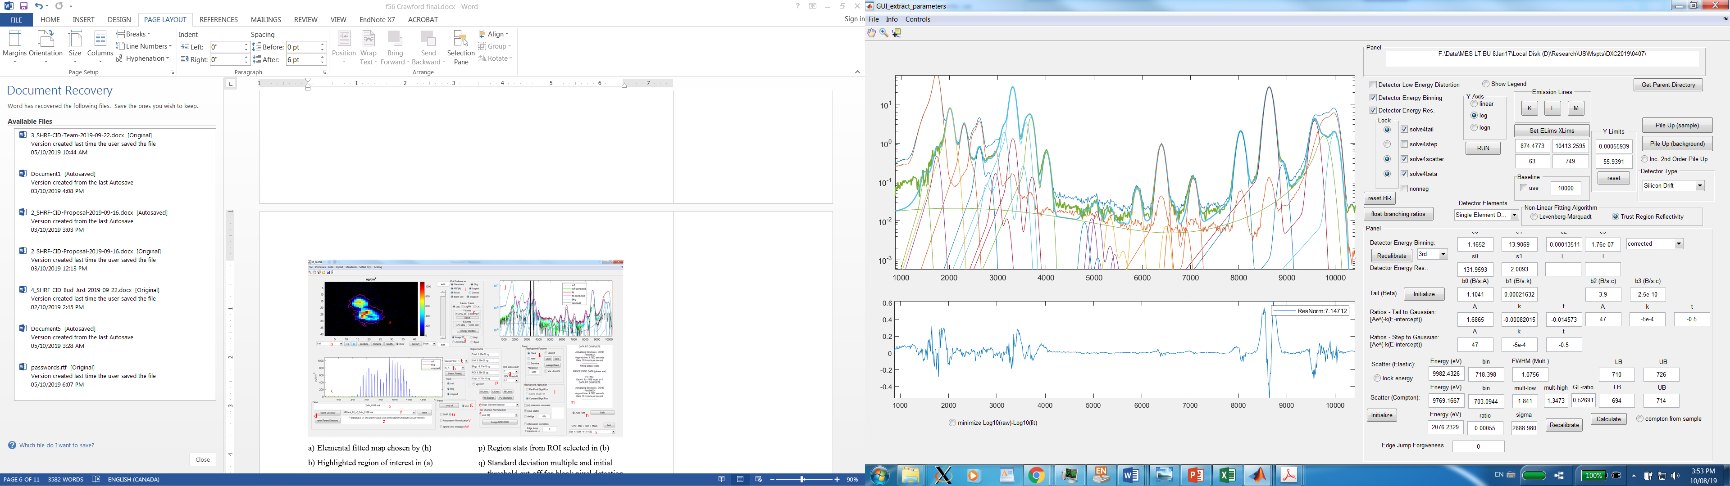
n₁
n₂
b₁
b₂
b₃
e₁
e₂
g
a₁
h₁
h₂
h₃
l₁
l₂
l₃
c₁
c₂
c₃
c₄
d₁
d₂
d₃
d₄
d₅
q
j₁
j₂
j₃
o₁
o₂
i
m
p
k
q₃
s₁
t₂
u₁
v₁
q₄
s₂
t₃
u₂
v₂
q₅
u₃
v₃
q₆
t₄
u₄
r
t₅
u₅
q₁ q₂
t₁
a₂
u₆
w₁ w₂ w₃ w₄ w₅ w₆
x₁ x₂ x₃ x₄ x₅ x₆ x₇
y₁
y₂ y₃ y₄ y₅ y₆ y₇
z

Slide 15
SAMPLE
SAMPLE

Slide 17
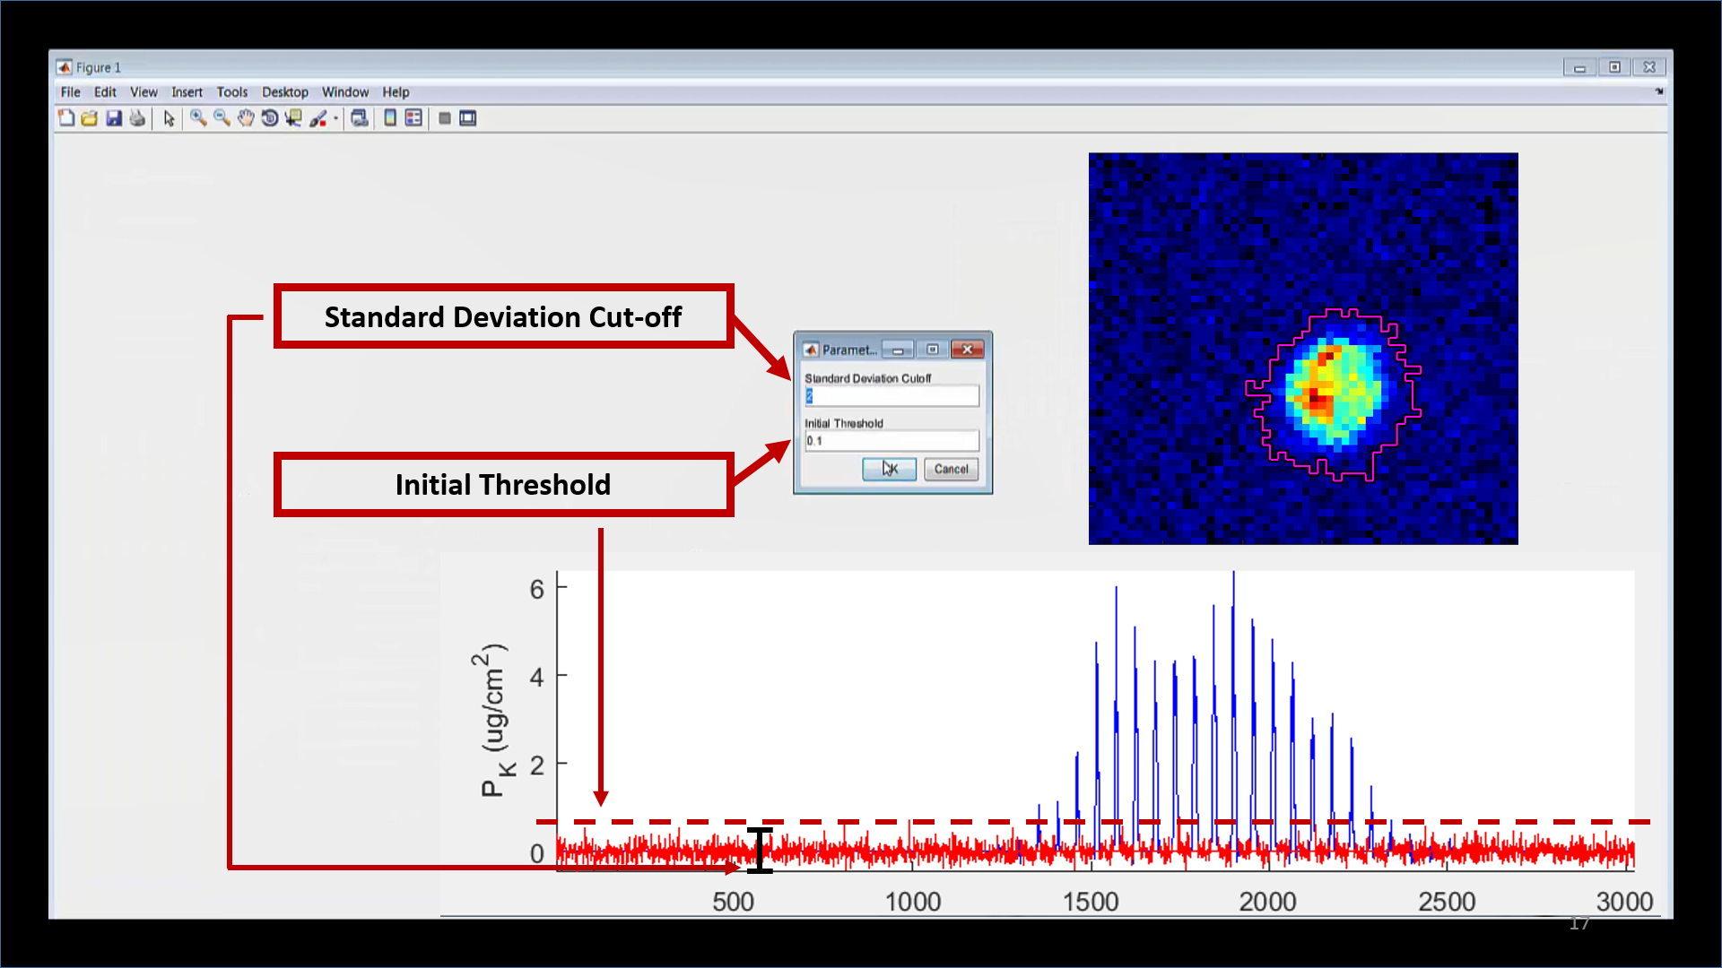

Slide 18
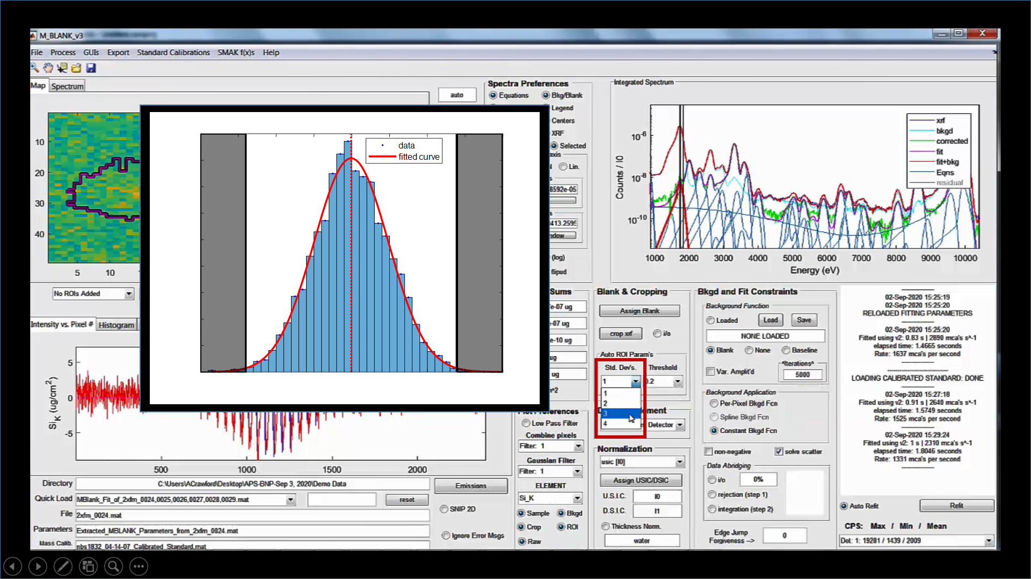

Slide 19
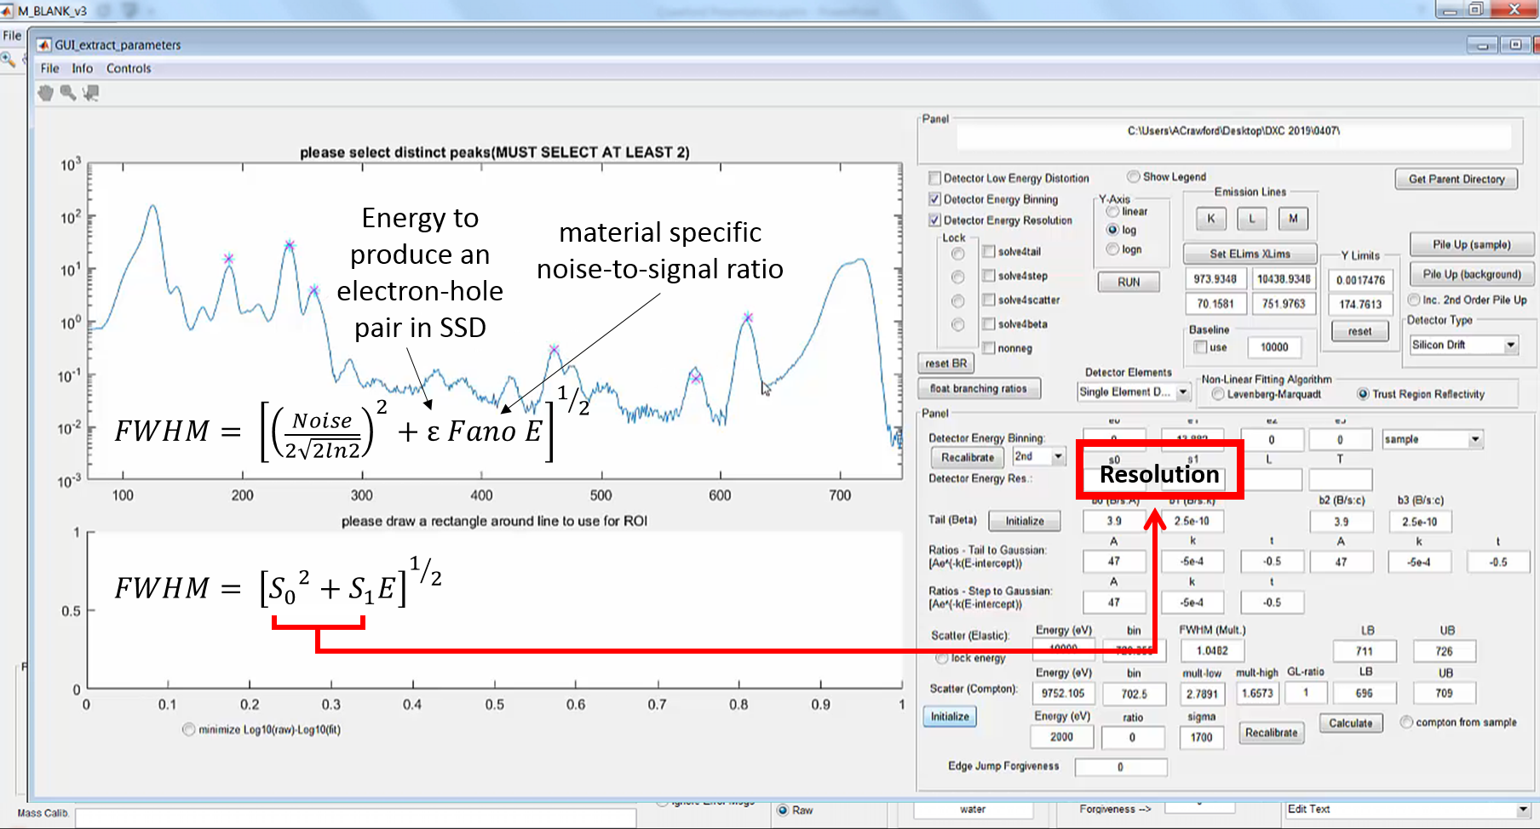

Slide 20
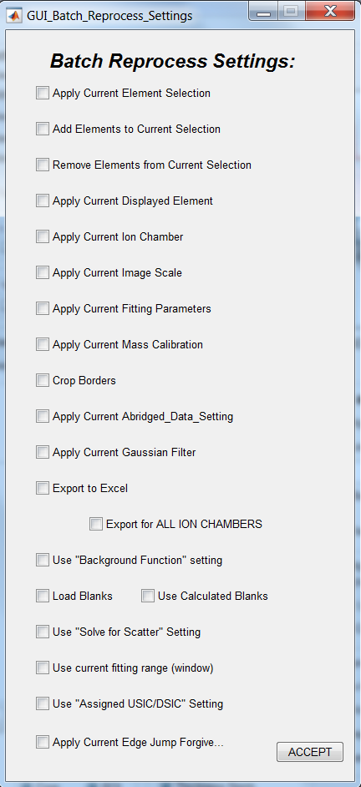
a
b
c
d
e
f
g
h
i
j
k
l
m
n
o p
q
r
s
t u

